Slide 1
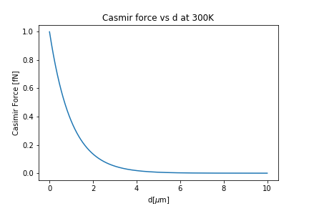
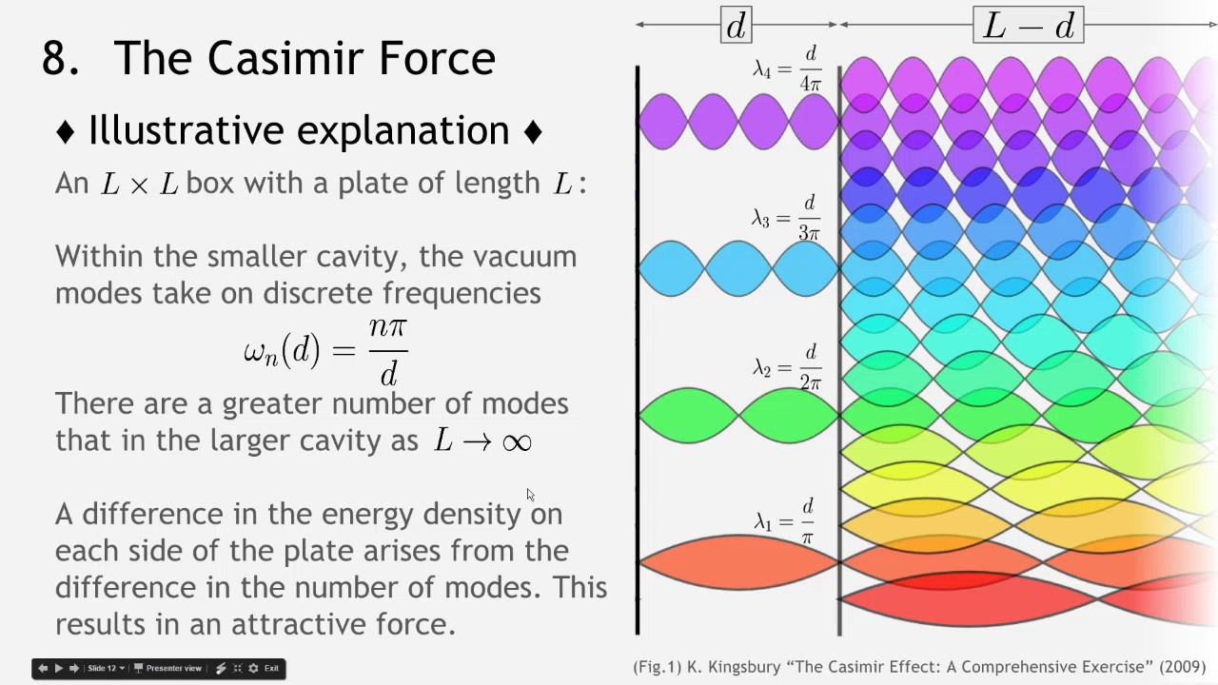
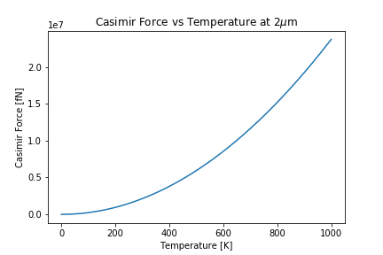
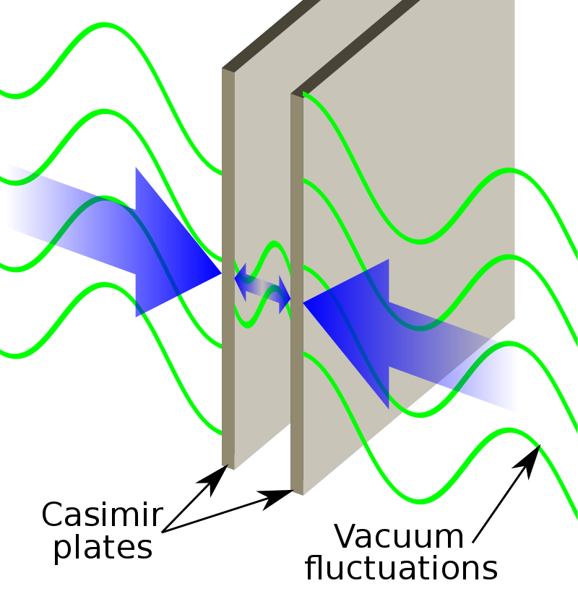
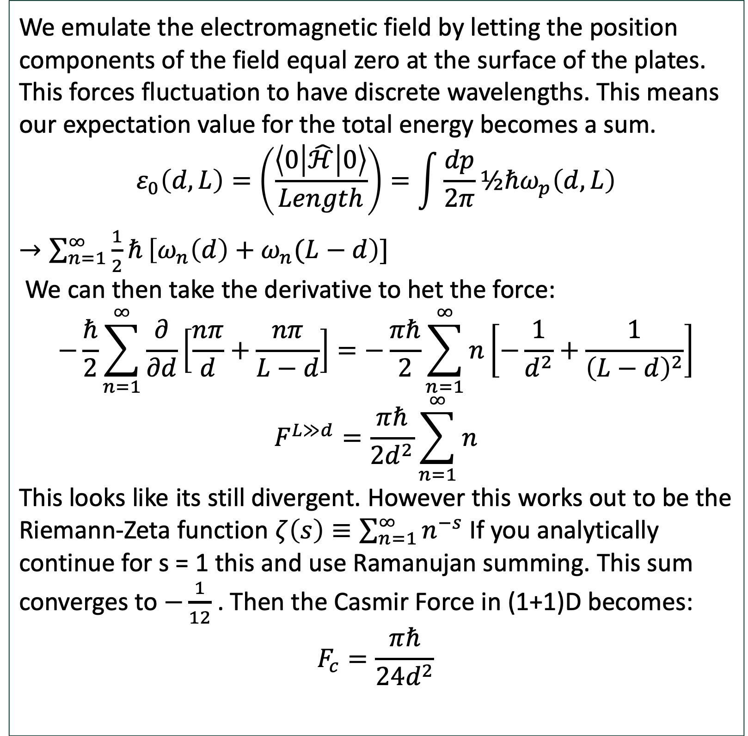
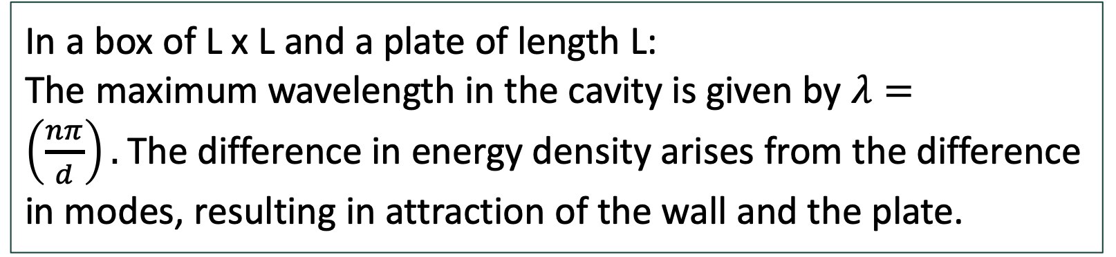
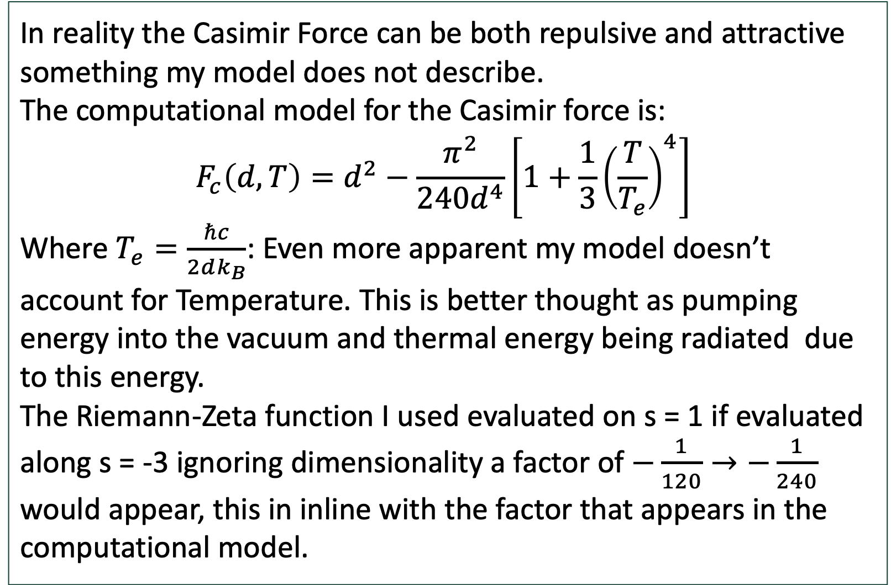
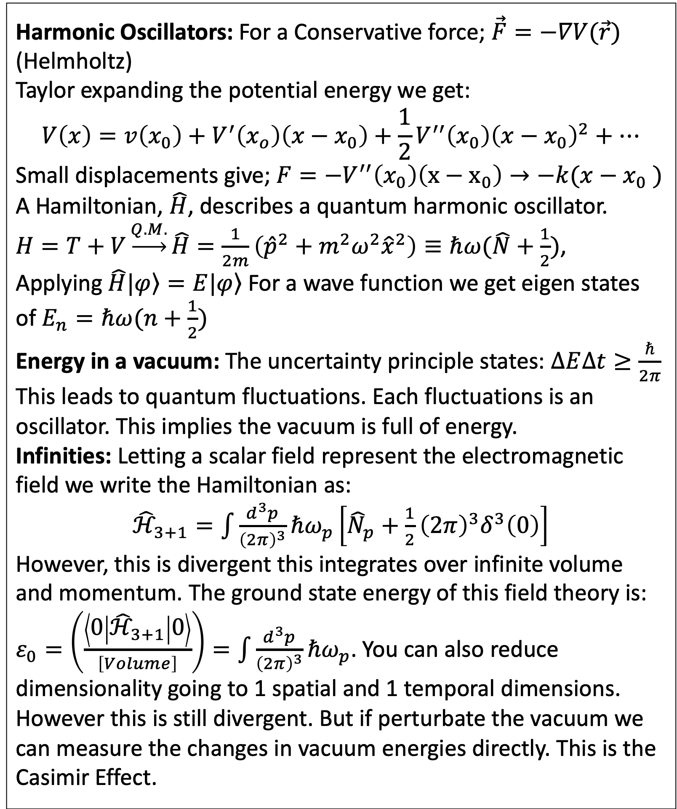
The Casmir Effect
Todd Lincoln
^{Michigan State University}
Abstract
The Casimir Effect
This project attempts form a baseline discussion of harmonic motion through to an elementary understanding of scalar quantum field theory. Using this a model of an infra-red divergence in the vacuum known as the Casimir effect. This Model works off the assumption of a true Riemann hypothesis. I will then compare it to a current computational model and attempt to explain any discrepancies.
Motivation
The Casmir effect arises from quantum fluctuations of particles in a vacuum, and is theoretical responsible for hawking radiation of black holes. This effect may be a link to general relativity and quantum field theory. Furthermore It may be of use in emerging nanotechnologies.
Introduction
In a box of L x L and a plate of length L:
The maximum wavelength in the cavity is given by $λ=\left(\frac{nπ}{d}\right).$The difference in energy density arises from the difference in modes, resulting in attraction of the wall and the plate.
Harmonic Oscillators: For a Conservative force; $\vec{F}=−∇V(\vec{r})$ (Helmholtz)
Taylor expanding the potential energy we get:
$$V\left(x\right)=v\left(x_{0}\right)+V^{′}\left(x_{o}\right)\left(x−x_{0}\right)+\frac{1}{2}V^{′′}\left(x_{0}\right){\left(x−x_{0}\right)}^{2}+…$$
Small displacements give; $F=−V^{′′}\left(x_{0}\right)\left(x−x_{0}\right)→−k(x−x_{0} )$
A Hamiltonian, $\hat{H}$, describes a quantum harmonic oscillator.
$H=T+V\underset{→}{Q.M.}\hat{H}=\frac{1}{2m}\left({\hat{p}}^{2}+m^{2}ω^{2}{\hat{x}}^{2}\right)≡ℏω(\hat{N}+\frac{1}{2})$,
Applying $\hat{H}\left.|φ\right\rangle =E|\left.φ\right\rangle$ For a wave function we get eigen states of $E_{n}=ℏω(n+\frac{1}{2})$
Energy in a vacuum: The uncertainty principle states: $∆E∆t≥\frac{ℏ}{2π}$ This leads to quantum fluctuations. Each fluctuations is an oscillator. This implies the vacuum is full of energy.
Infinities: Letting a scalar field represent the electromagnetic field we write the Hamiltonian as:
${\hat{ℋ}}_{3+1}=\int{\frac{d^{3}p}{{\left(2π\right)}^{3}}}ℏω_{p}\left[{\hat{N}}_{p}+\frac{1}{2}{\left(2π\right)}^{3}δ^{3}\left(0\right)\right]$
However, this is divergent this integrates over infinite volume and momentum. The ground state energy of this field theory is: $ε_{0}=\left(\frac{\left\langle 0 | {\hat{ℋ}}_{3+1} | 0\right\rangle }{\left[Volume\right]}\right)=\int{\frac{d^{3}p}{{\left(2π\right)}^{3}}}ℏω_{p}$. You can also reduce dimensionality going to 1 spatial and 1 temporal dimensions. However this is still divergent. But if perturbate the vacuum we can measure the changes in vacuum energies directly. This is the Casimir Effect.
Mathematical Model
We emulate the electromagnetic field by letting the position components of the field equal zero at the surface of the plates. This forces fluctuation to have discrete wavelengths. This means our expectation value for the total energy becomes a sum.
$$ε_{0}\left(d,L\right)=\left(\frac{\left\langle 0 | \hat{ℋ} | 0\right\rangle }{Length}\right)=\int{\frac{dp}{2π}}½ℏω_{p}\left(d,L\right)$$
$→\sum_{n=1}^{∞}{\frac{1}{2}ℏ}\left[ω_{n}\left(d\right)+ω_{n}(L−d\right)]$
We can then take the derivative to het the force:
$$−\frac{ℏ}{2}\sum_{n=1}^{∞}{\frac{∂}{∂d}\left[\frac{nπ}{d}+\frac{nπ}{L−d}\right]}=−\frac{πℏ}{2}\sum_{n=1}^{∞}{n\left[−\frac{1}{d^{2}}+\frac{1}{{\left(L−d\right)}^{2}}\right]}$$
$$F^{L≫d}=\frac{πℏ}{2d^{2}}\sum_{n=1}^{∞}{n}$$
This looks like its still divergent. However this works out to be the Riemann-Zeta function $ζ\left(s\right)≡\sum_{n=1}^{∞}{n^{−s}}$ If you analytically continue for s = 1 this and use Ramanujan summing. This sum converges to $−\frac{1}{12}$ . Then the Casmir Force in (1+1)D becomes:
$$F_{c}=\frac{πℏ}{2{4d}^{2}}$$
Discussion
The Casmir Effect is still an active area of research. This model assumed no interference, in reality coupled oscillators or multiple waves would interact. Similarly a full rigorous treatment of relativity and quantum mechanics was not applied. Let alone a true electromagnetic field rather then a scalar field. Furthermore other methods of renormalization would need to be attempted to see if the results are consistent. The temperature/ heat energy of the system was not considered and dimensionality reduced. It appears that in the 3+1N dimension the model is in the same neighborhood as the computational model. Although that is encouraging the Riemann Hypothesis remains unproven so This model is build on assumption that it is true. So for this to be valid the Riemann Hypothesis would have to be proven first.
Conclusion
In this project I attempted to make a model of the Casimir’s Effect based off reduced dimensionality, Simplified field, and the presumption of validity of Riemann-Zeta functions. This model captured the basic form of Casmir's effect but lost generality due to the assumptions made. The future of study of this phenomena will require a more rigorous approach. The continued study of this effect may give better insight to the relation between Quantum field theory and Electromagnetism. With research being don from a topological perspective, perhaps even gravity/General Relativity may be able to be connected as well.
Comparison to Empirical Models
In reality the Casimir Force can be both repulsive and attractive something my model does not describe.
The computational model for the Casimir force is:
$$F_{c}\left(d,T\right)=d^{2}−\frac{π^{2}}{240d^{4}}\left[1+\frac{1}{3}{\left(\frac{T}{T_{e}}\right)}^{4}\right]$$
Where $T_{e}=\frac{ℏc}{2dk_{B}}$: Even more apparent my model doesn’t account for Temperature. This is better thought as pumping energy into the vacuum and thermal energy being radiated due to this energy.
The Riemann-Zeta function I used evaluated on s = 1 if evaluated along s = -3 ignoring dimensionality a factor of $−\frac{1}{120}→−\frac{1}{240}$ would appear, this in inline with the factor that appears in the computational model.

